Slide 1
Collision avoidance of the Yahboom JetBot
2021.01.20
DGIST
Jaewoo Park

Slide 2
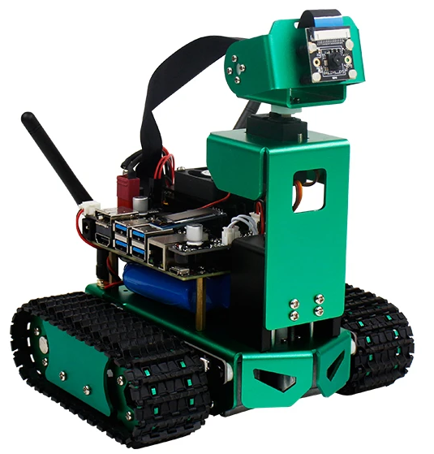
주간 회의
One Sentence Summary
I did some investigation about the JetBot and set up the environment.
What is (Yahboom) JetBot?
JetBot is a ‘Robot Platform’ driven by the NVIDIA Jetson Nano.
Yahboom JetBot is one of the implementations of the platform.
Camera (2 DOF)
NVIDIA Jetson Nano
(Remotely Programmable)
Docs: https://jetbot.org/master
GitHub Repo.: https://github.com/NVIDIA-AI-IOT/jetbot

Slide 3
주간 회의
Collision Avoidance
Purpose: Let JetBot drive autonomously in a given area without any collision.
Method: Image Classification(2 classes) trained by ResNet18(PyTorch).
Object

Slide 4
주간 회의
Timeline
Planed: Implement the method on the JetBot.
Failed: No Jetson Nano in the Lab.
Solution: Implement the method on the Laptop.
Failed: Cannot use CUDA(GPU) on my laptop.
Solution: Implement the method on the Jetson TX2 Dev. kit.
Failed: Environment setting is required.
Solution: Set the development environment by using the JetPack*.
Plans: Complete the environment setting and Implement the method.
*JetPack: SDK for the NVIDIA Jetson series

